Slide 1

Inventory Management System
Project Presentation
on
Institute of Information and Communication Technology
Bangladesh University of Engineering and Technology (BUET)

Slide 2
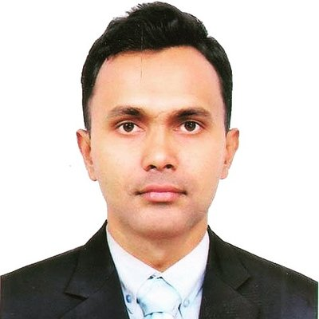
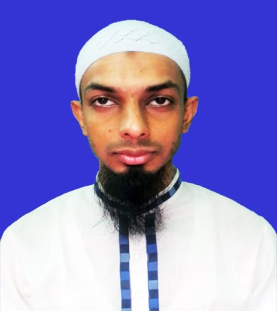
Contributed By
Md. Dedarul Hasan
Student ID:0417311011
PDG in ICT,
IICT,BUET
Sk. Md. Zubayer-Al-Mahmud
Student ID:1017311014
PDG in ICT,
IICT,BUET
Institute of Information and Communication Technology
Bangladesh University of Engineering and Technology (BUET)

Slide 3

Task Introduction -Inventory Management System
FRAMEWORK:
Java + Mysql+ Jasper Report [Integration]
FEATURES:
Login-Registration-Logout,
Java Swing Framework Crud & Search
Form Validation, Debug & Testing,
Report Making Static & Dynamic
Institute of Information and Communication Technology
Bangladesh University of Engineering and Technology (BUET)

Slide 4
Materials And IDE-Tools
Netbean
MySQL
Jasper Report [iReport Plugin]
Sublime Text Editor
Debuger
Jdk
Project Related Jar and Library
Institute of Information and Communication Technology
Bangladesh University of Engineering and Technology (BUET)

Slide 5
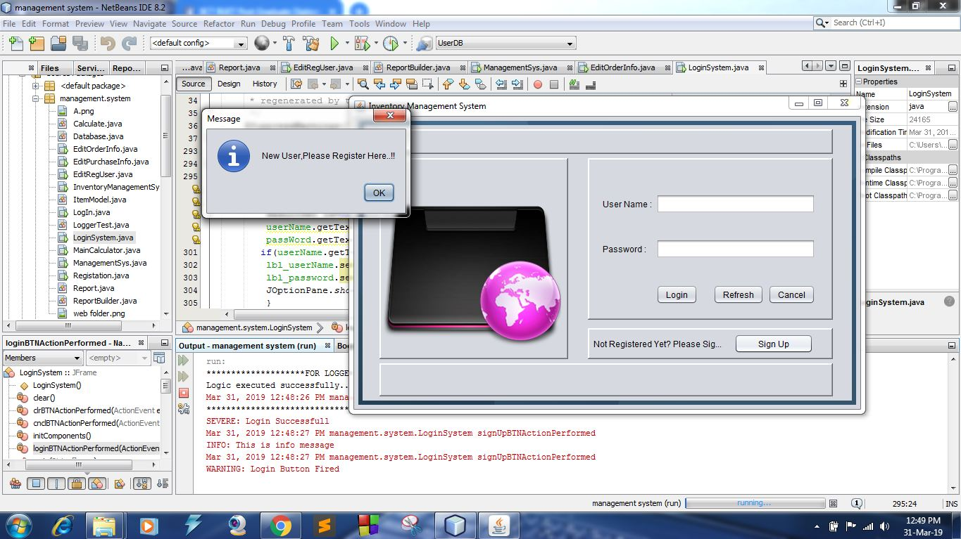
Registration
Institute of Information and Communication Technology
Bangladesh University of Engineering and Technology (BUET)

Slide 6
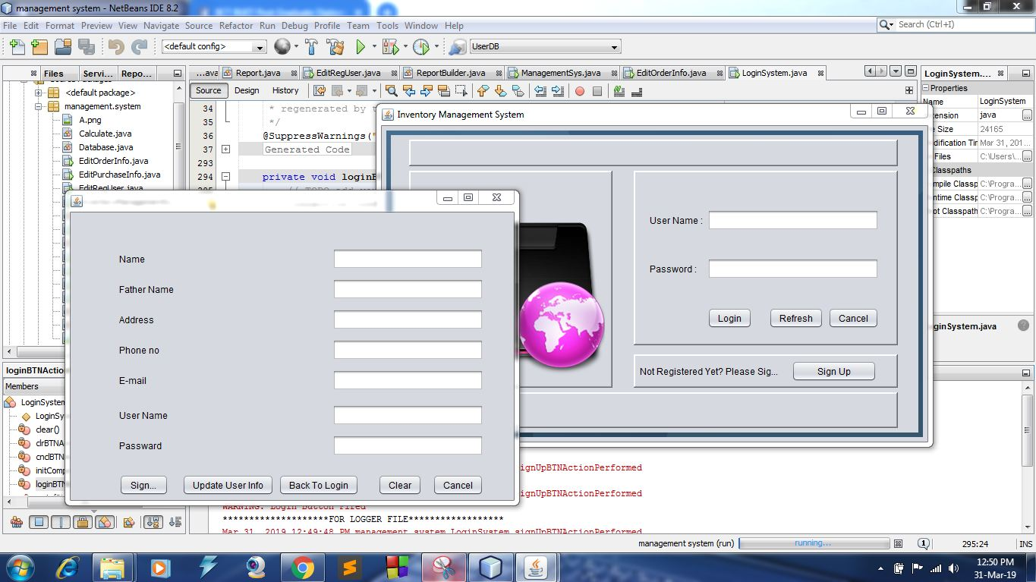
Registration
Institute of Information and Communication Technology
Bangladesh University of Engineering and Technology (BUET)

Slide 7
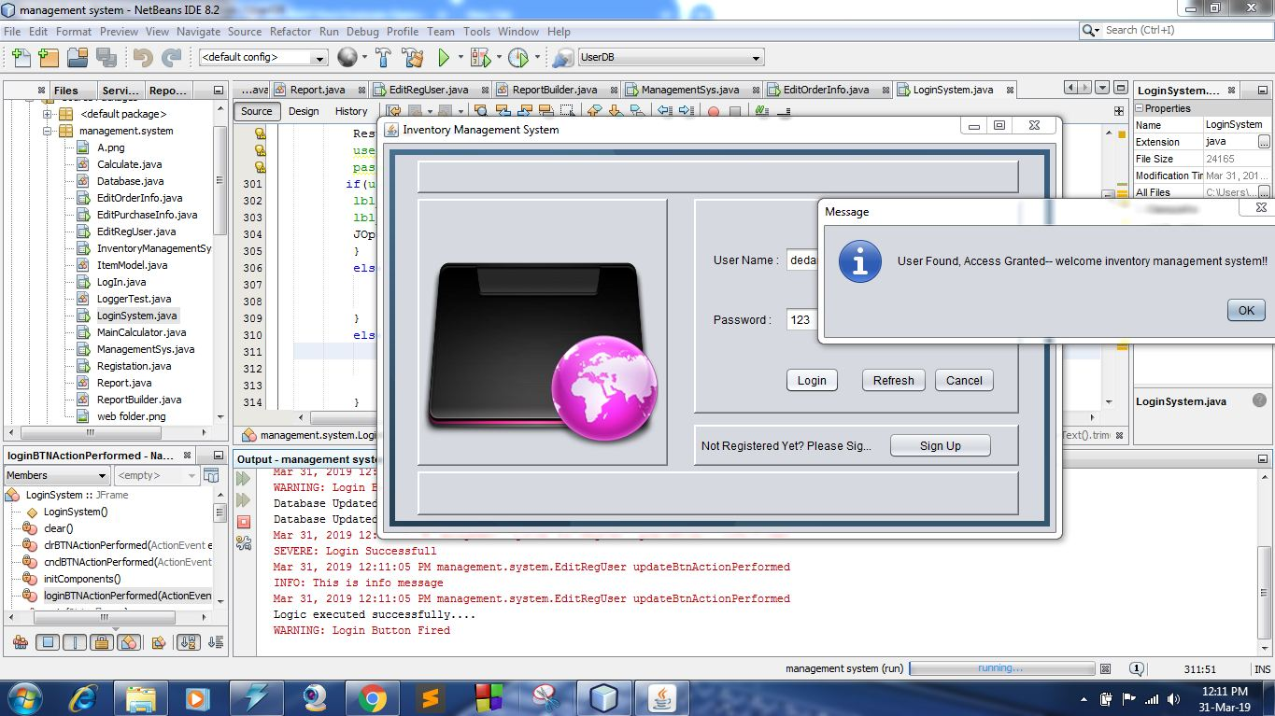
Log In
Institute of Information and Communication Technology
Bangladesh University of Engineering and Technology (BUET)

Slide 8
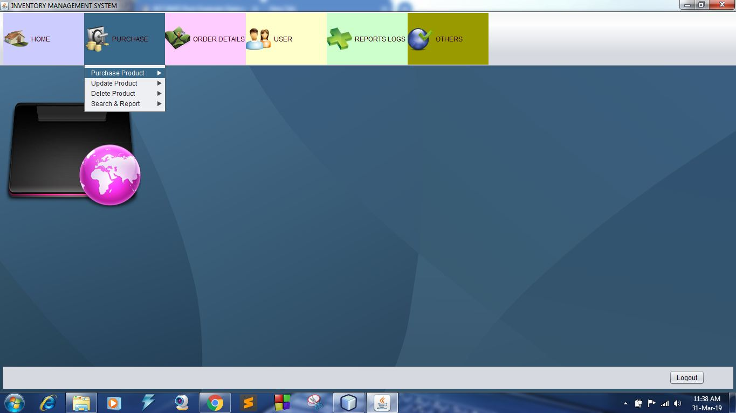
Inventory Window
Create Purchase Product
Update Purchased Product
Delete Purchased Product
Search Purchased Product
Report Purchased Product [Static]
Report Purchased Product [Dynamic]
Institute of Information and Communication Technology
Bangladesh University of Engineering and Technology (BUET)

Slide 9
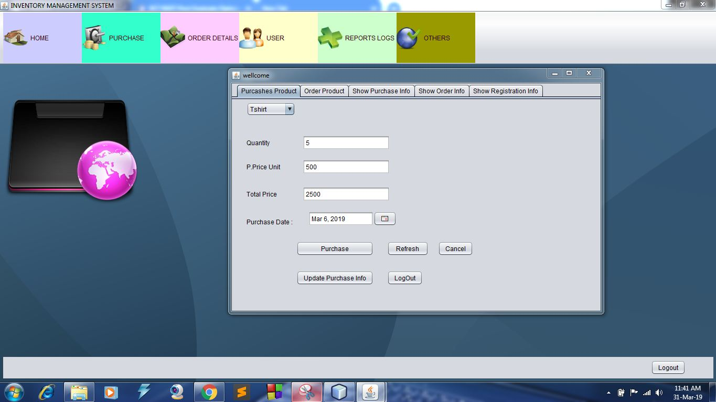
Inventory Window
Create Purchase Product
Institute of Information and Communication Technology
Bangladesh University of Engineering and Technology (BUET)

Slide 10
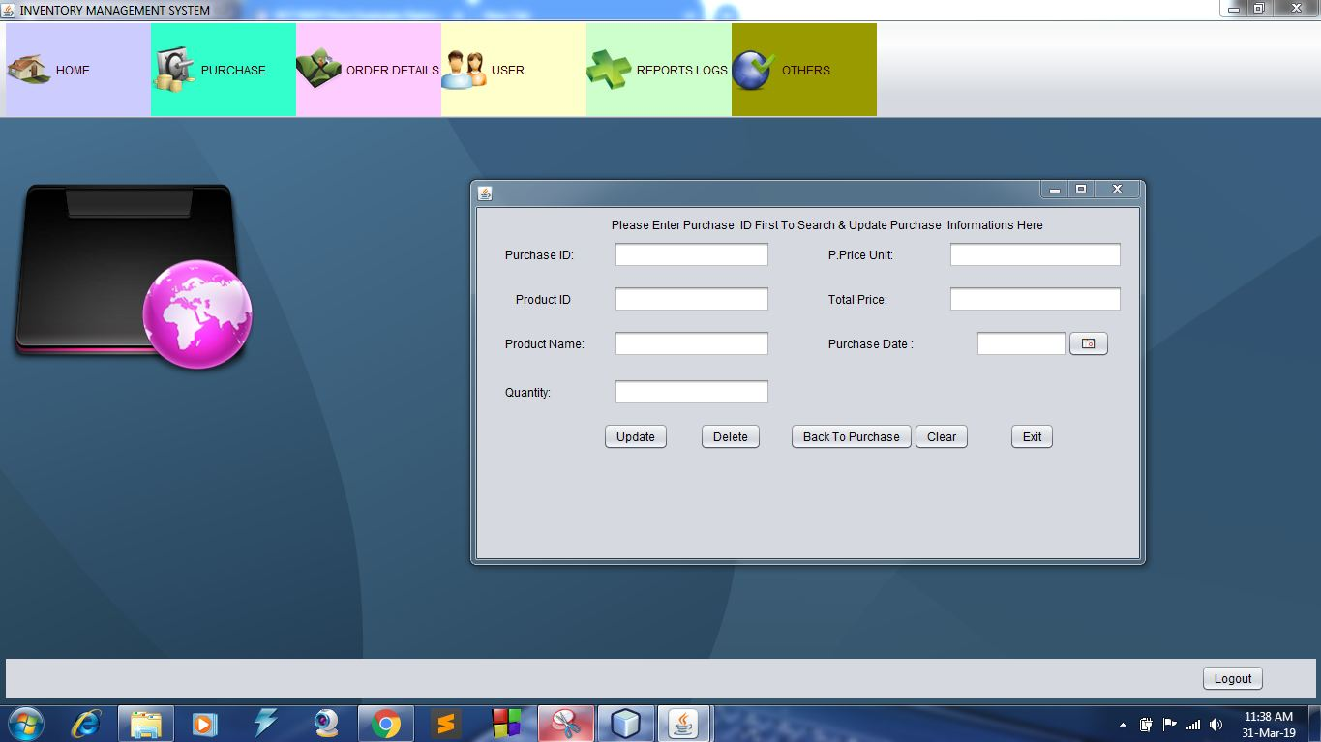
Inventory Window
Update Purchase Product
Institute of Information and Communication Technology
Bangladesh University of Engineering and Technology (BUET)

Slide 11
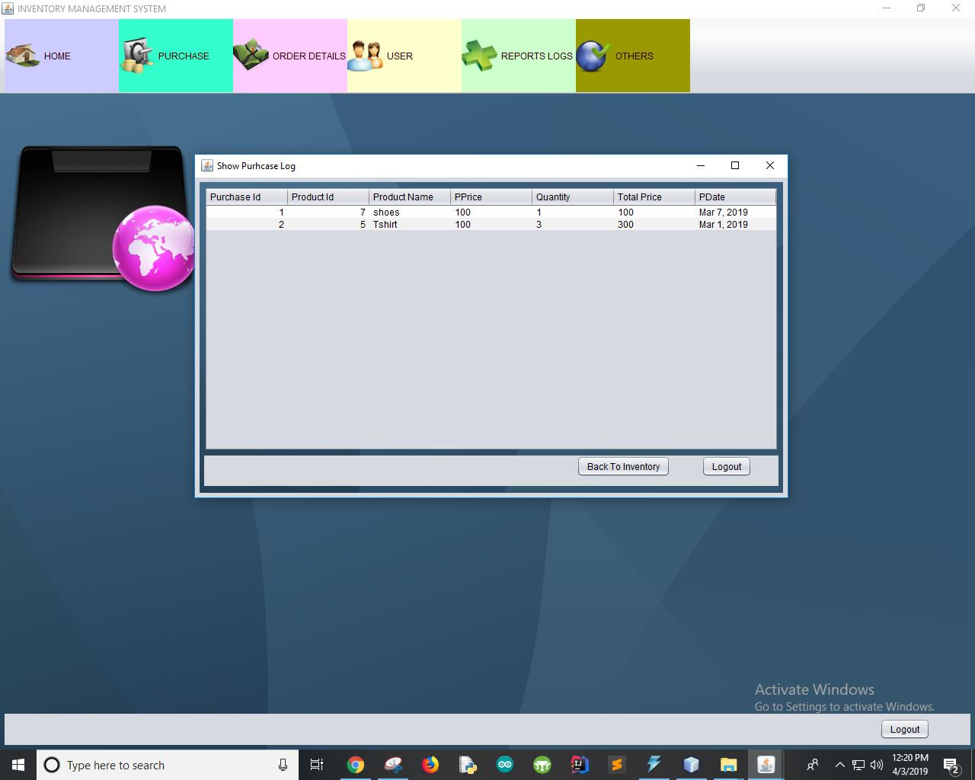
Inventory Window
Show Purchase Table
Institute of Information and Communication Technology
Bangladesh University of Engineering and Technology (BUET)

Slide 12
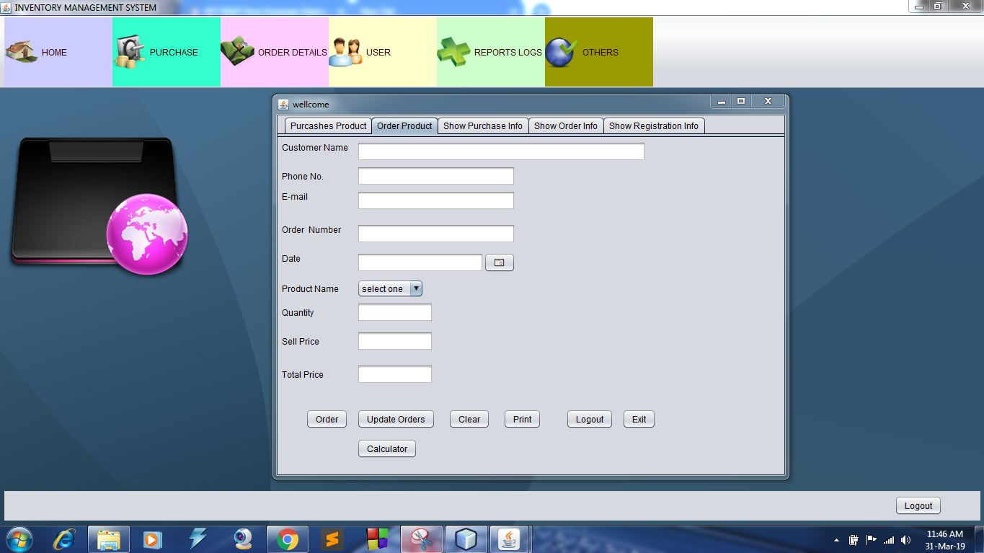
Inventory Window
Create Order
Update Order
Delete Order
Search Order
Report Order [Static]
Report Order [Dynamic]
Institute of Information and Communication Technology
Bangladesh University of Engineering and Technology (BUET)

Slide 13
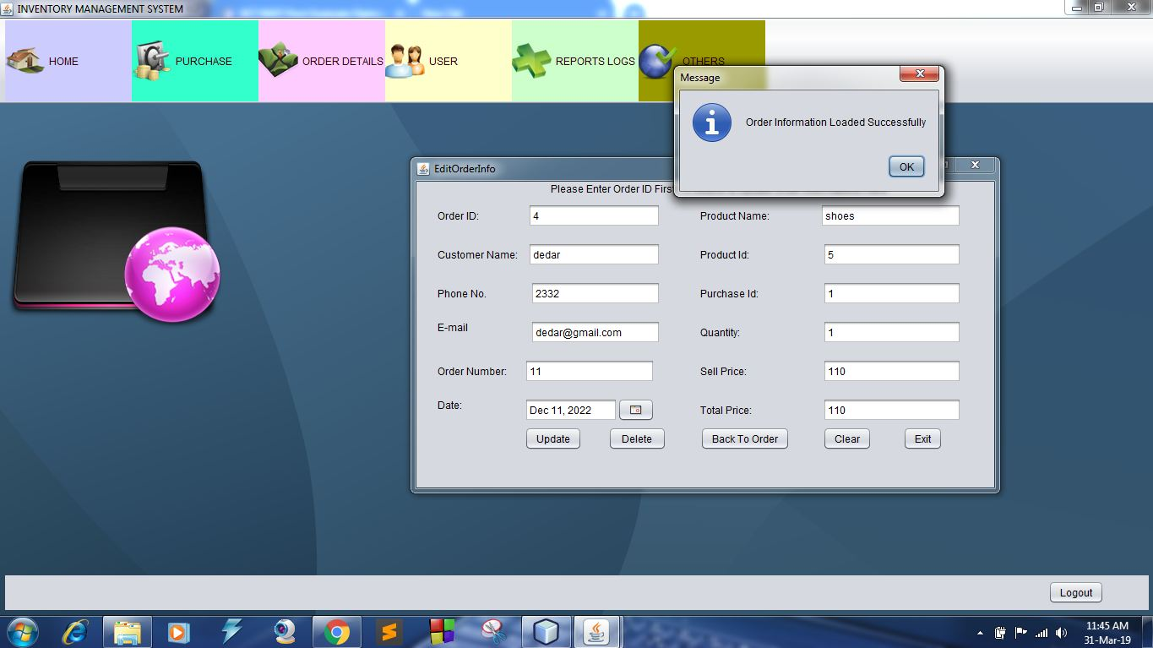
Inventory Window
Update Order
Institute of Information and Communication Technology
Bangladesh University of Engineering and Technology (BUET)

Slide 14
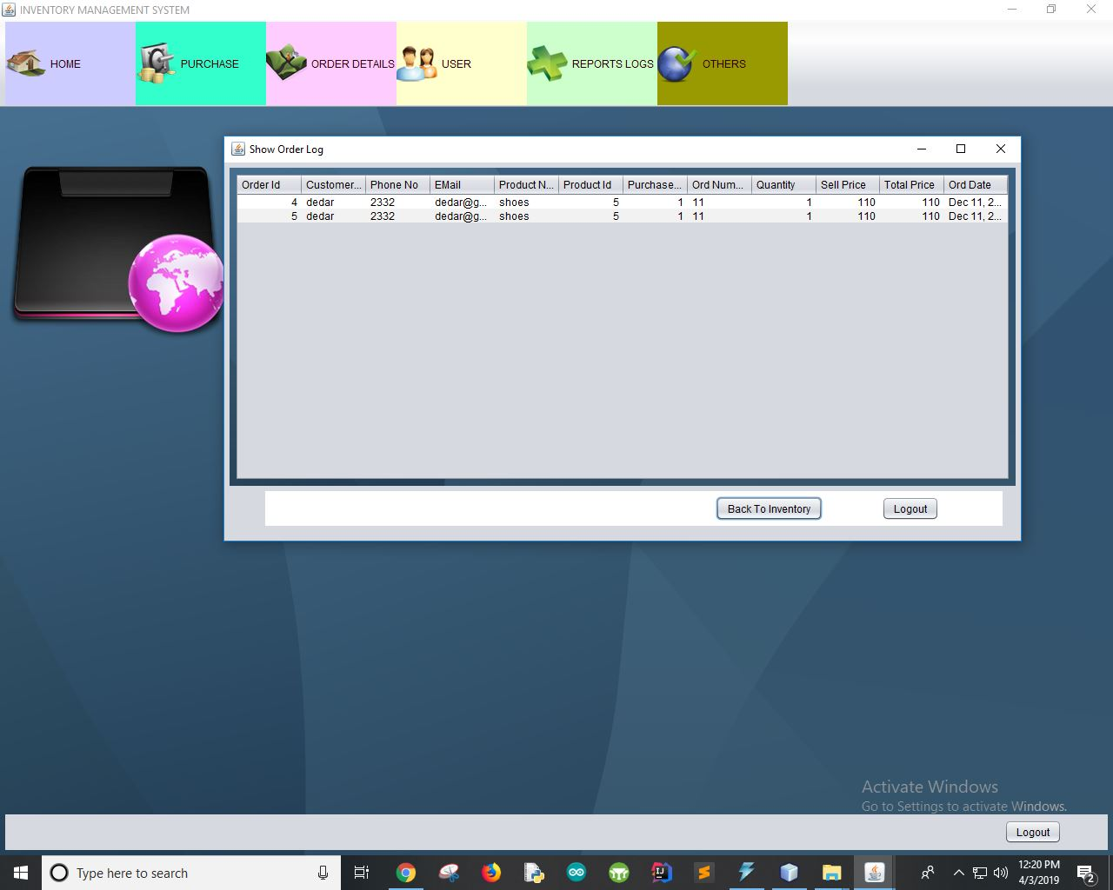
Inventory Window
Show Order Table
Institute of Information and Communication Technology
Bangladesh University of Engineering and Technology (BUET)

Slide 15
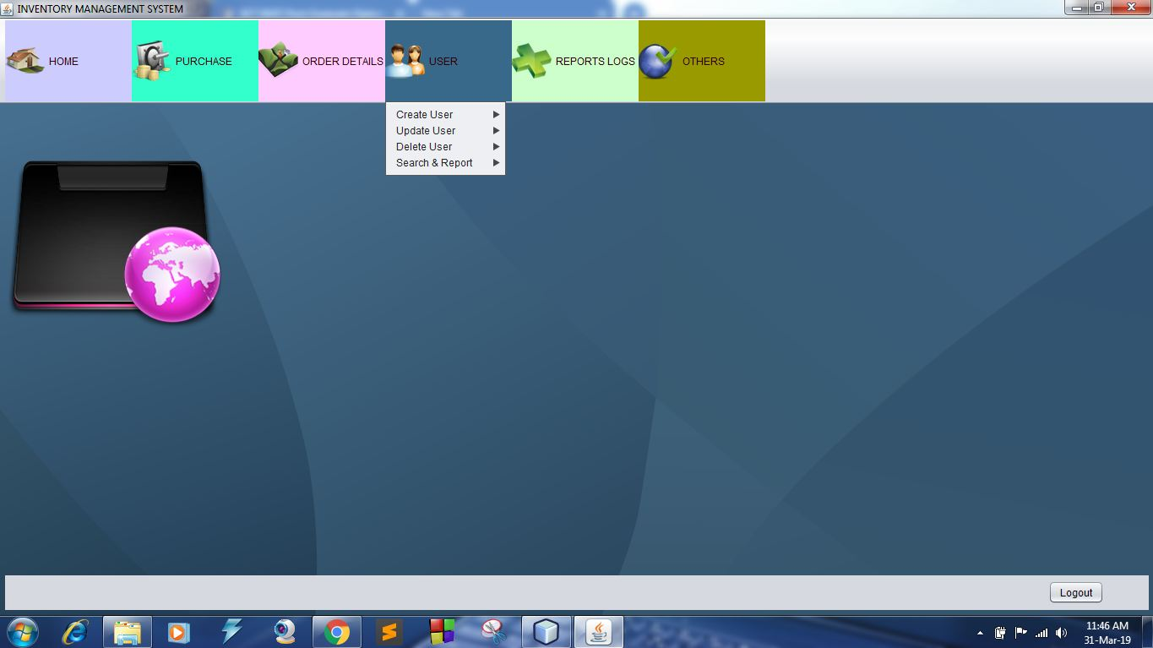
Inventory Window
Update User
Delete User
Search User
Report User [Static]
Report User [Dynamic]
Institute of Information and Communication Technology
Bangladesh University of Engineering and Technology (BUET)

Slide 16
Inventory Window
Create User to Registration
Institute of Information and Communication Technology
Bangladesh University of Engineering and Technology (BUET)

Slide 17
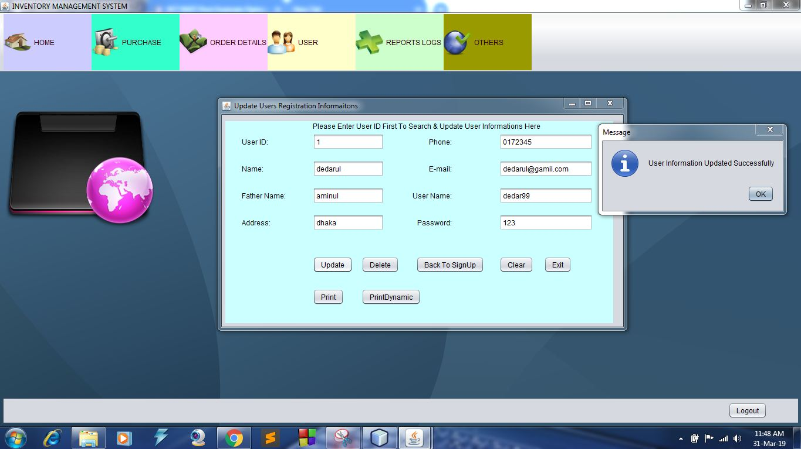
Inventory Window
Update User
Institute of Information and Communication Technology
Bangladesh University of Engineering and Technology (BUET)

Slide 18
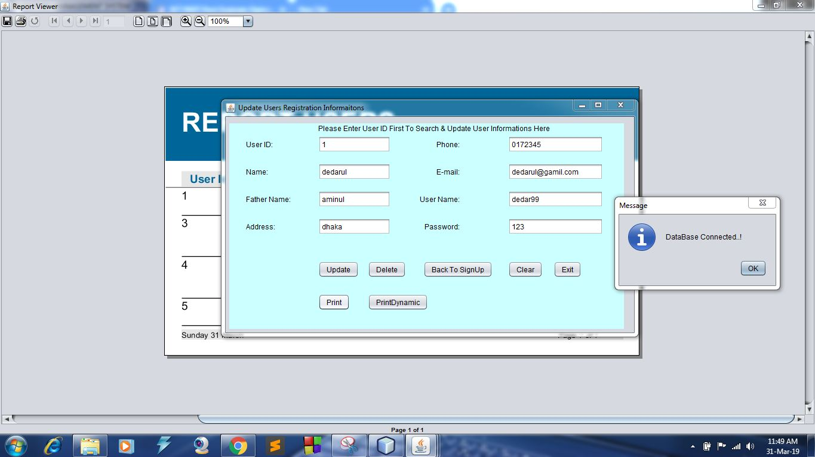
Inventory Window
User Report
Institute of Information and Communication Technology
Bangladesh University of Engineering and Technology (BUET)

Slide 19
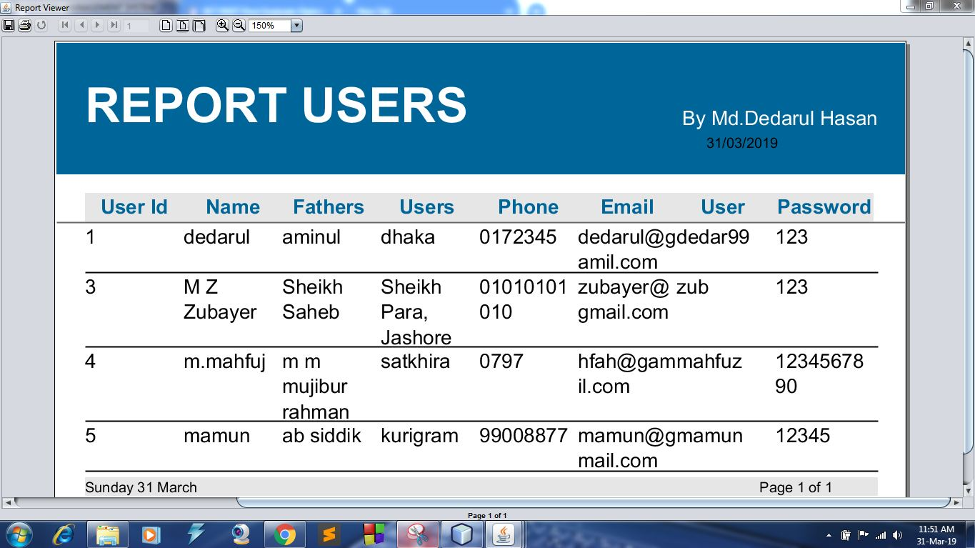
Inventory Window
User Report
Institute of Information and Communication Technology
Bangladesh University of Engineering and Technology (BUET)

Slide 20
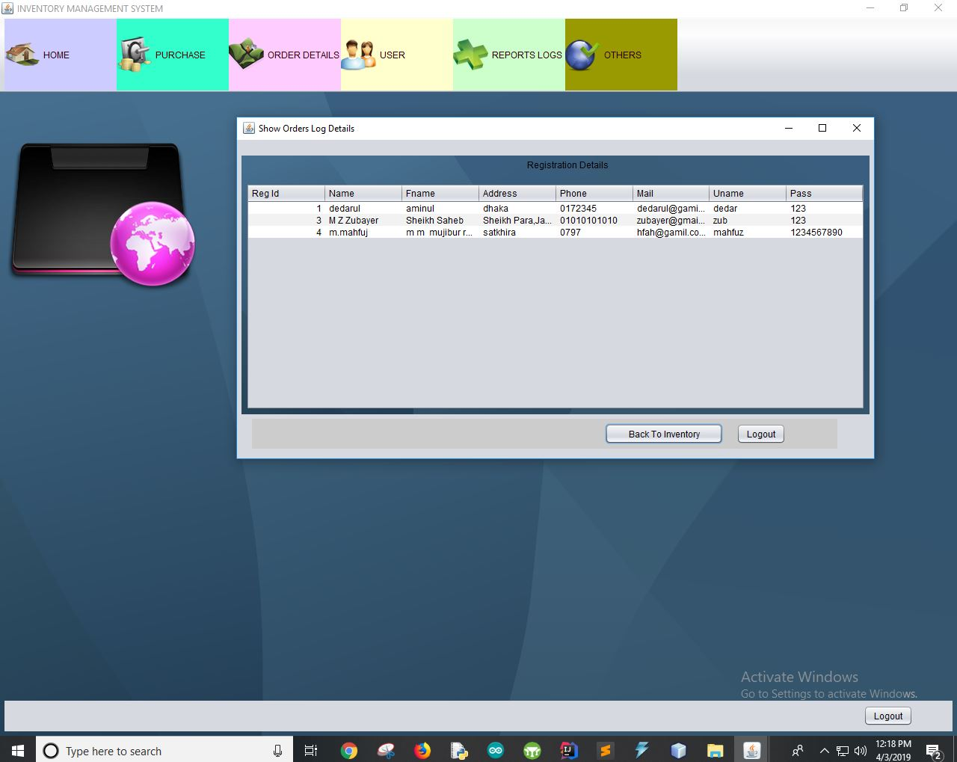
Inventory Window
Show User Table
Institute of Information and Communication Technology
Bangladesh University of Engineering and Technology (BUET)

Slide 21
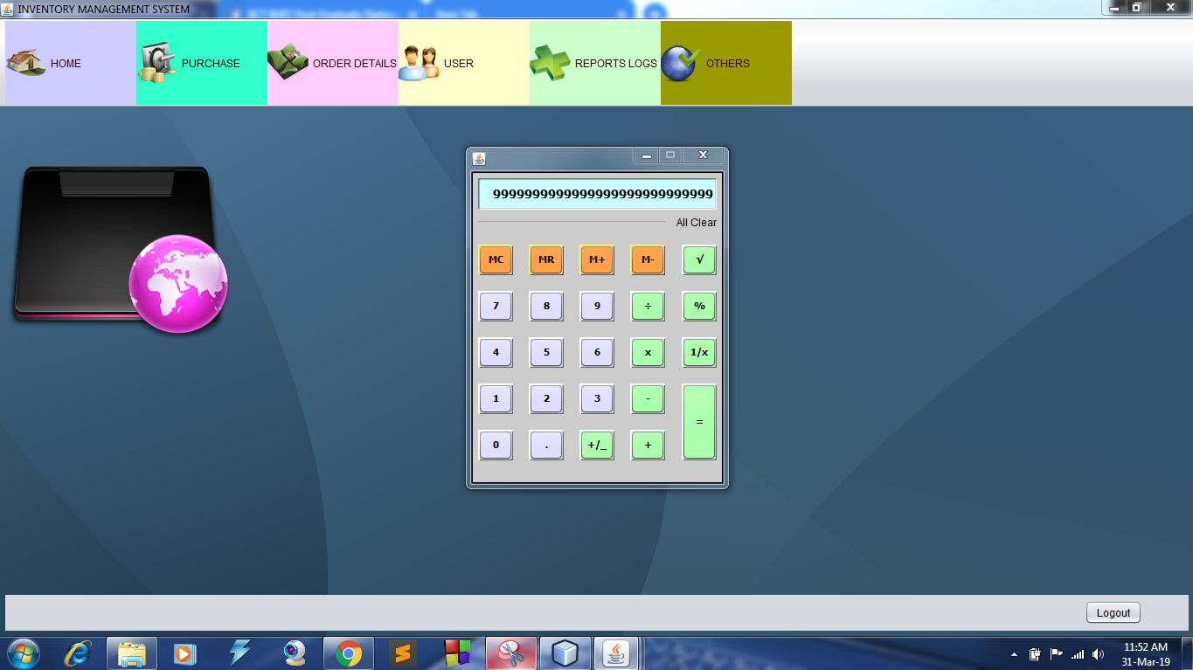
Inventory Window
Calculator
Institute of Information and Communication Technology
Bangladesh University of Engineering and Technology (BUET)

Slide 22
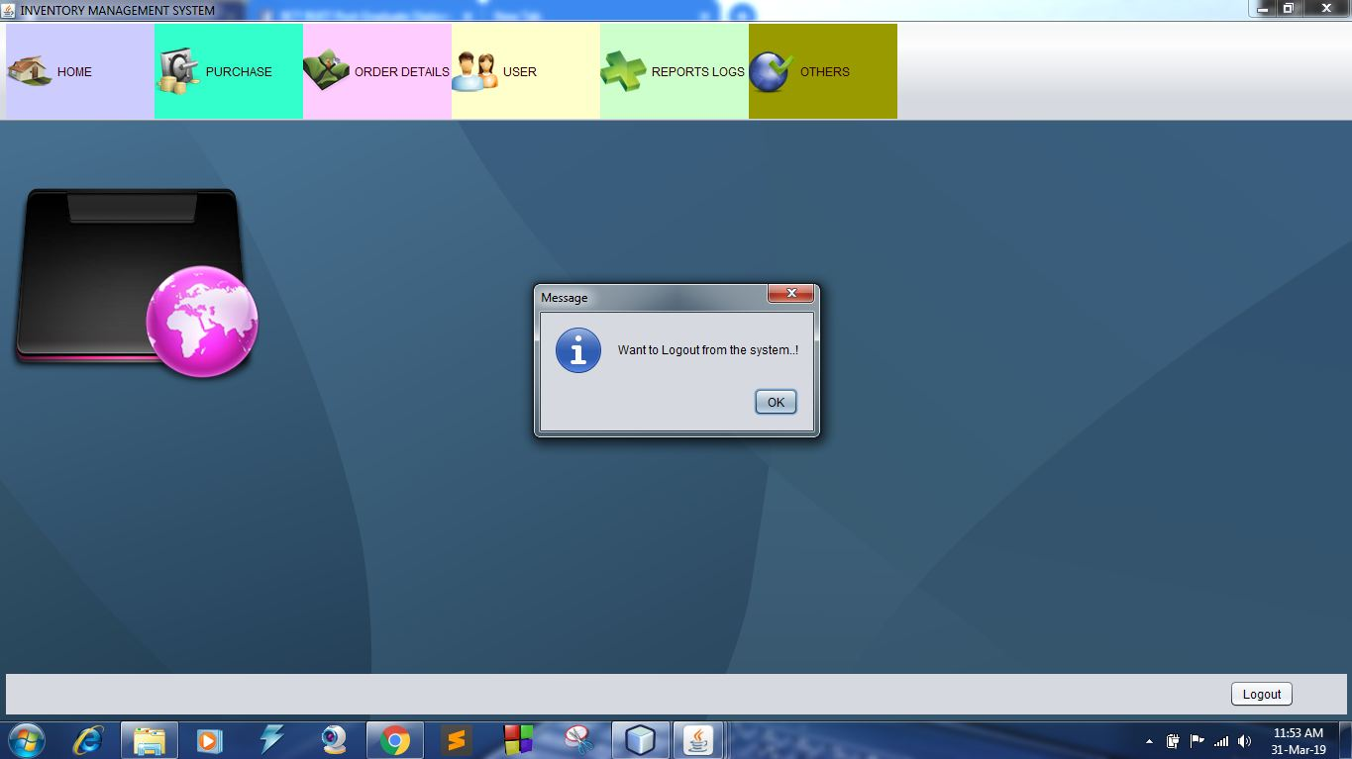
Log Out
Institute of Information and Communication Technology
Bangladesh University of Engineering and Technology (BUET)

Slide 23
Refference
Stack Overflow
JasperCommunity
Open Source Initiative
Dzone
MyKong
TutorialsPoint
GeeksforGeeks
Hacker.io
Java2s and Java4s
JavaTpoint
Dinesh on Java
Rose India
Others Blog & Forum
Institute of Information and Communication Technology
Bangladesh University of Engineering and Technology (BUET)

Slide 24
Thanks
Institute of Information and Communication Technology
Bangladesh University of Engineering and Technology (BUET)

